Slide 1

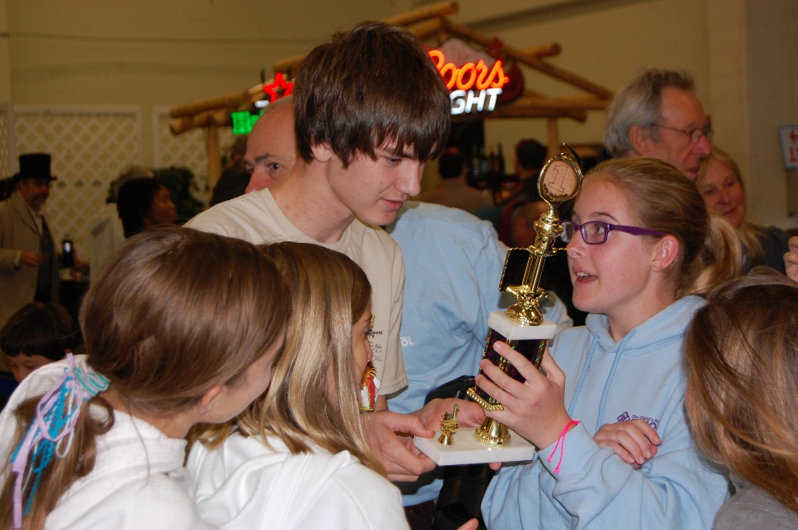
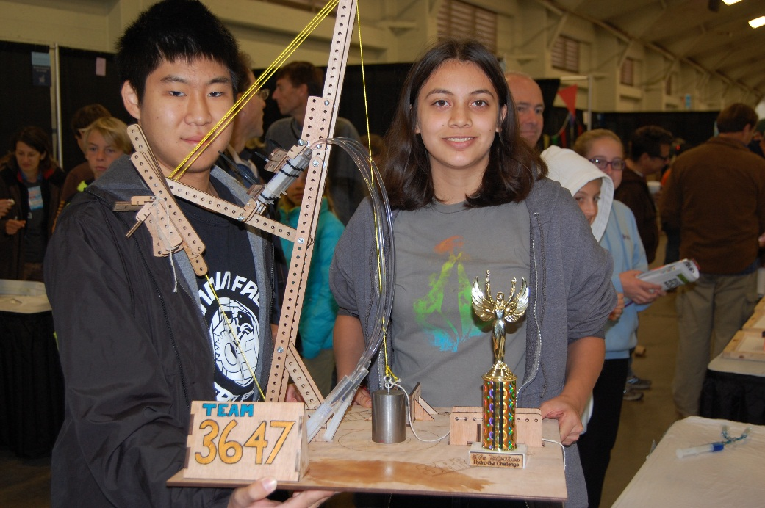
Six simple mechanical machines in the PhyzAI Hydro-Bot Challenge
Machines & Work
Notes:
We live in a world full of machines. Some of the machines are simple while others are more complex. There are examples of them everywhere. In schools, in kitchens, in restaurants, at sporting events, just about anywhere you could think of.
The Super-Lift Challenge is an example of many different types of the machines working together to complete the task of lifting a weight as high off the platform as possible.
—--
In the bustling cosmos of contraptions, we're surrounded by machines of all shapes and sizes. From the **simple** to the **sophisticated**, they're the unsung heroes of our daily lives. You'll find them in classrooms, cooking up a storm in kitchens, serving up convenience in restaurants, and even cheering on teams at sporting events – they're virtually everywhere you look!
The Super-Lift Challenge? It's a spectacular showcase of these mechanical marvels teaming up. Their mission: to elevate a weight to soaring heights, far above the launchpad. It's a testament to the power of unity and engineering ingenuity!

Slide 2


What is work?
The scientific definition of work is: the transfer of energy that occurs when a force makes an object move.
In order to do work the force applied must move the object in the same direction as the applied force.
Direction of force
Direction of motion
Notes:
Okay. So let's take a look at work. Work has many definitions. Some of us think of work as something we do to earn money or perhaps you think of the hard work you do in school completing your work on time.
But work in a scientific sense means applying a force to an object and having that object move in the same direction that the force was applied. An example of this would be pushing a grocery cart through the grocery store.
Okay, let's look at another example. Suppose you see a classmate carrying a bunch of books down the hallway. Are they doing work? Actually, they're not. The force that is lifting the books is different than the horizontal motion of your legs carrying you down the hall.
Remember, in order for work to take place, the force must cause an object to move in the direction that the force is being applied.
_____
Alright, let's demystify the concept of **work**. Now, when you hear 'work', you might think of your job that earns you credits or the diligent effort you put into your studies to ace that space exam.
But in the realm of physics, work has a very specific meaning. It's all about applying a **force** to an object and that object moving in the **exact direction** of the force. Imagine propelling a shopping module through the aisles of a cosmic mart.
Here's a brain-bender: if you spot a fellow student navigating the space station's corridor with an armful of data pads, are they doing work? In the scientific sense, nope! The force they're using to keep the data pads aloft is vertical, while they're moving horizontally.
So, remember, for scientific work to occur, the force applied must make the object move along with it. That's the power of physics in motion!

Slide 3

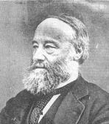
Calculating Work
work = force x distance
The amount of work done depends on the amount of force exerted and the distance over which the force is applied.
Force is measured in newtons, and the meter is the basic SI unit for distance. Therefore, the unit used to express work is the newton-meter, which is simply called the joule.
The unit to express work is named after British physicist James Prescott Joule.
Notes:
Work can be calculated by multiplying the force applied to the object which is measured in newtons and the distance measured in meters through which the force is applied. Work is measured in newton meters or more simply, joules.
Remember, the amount of work done depends on the amount of force applied and the distance over which the force is applied. So if you're at the gym and you're watching two weightlifters lifting weights, how can you figure out which one is doing more work? Is it the one who's lifting 160 newton bar, 1 meter over their head or the weightlifter lifting 80 newton bar two meters over their head? Well, actually they're both doing the same amount of work, 160 joules.

Slide 4

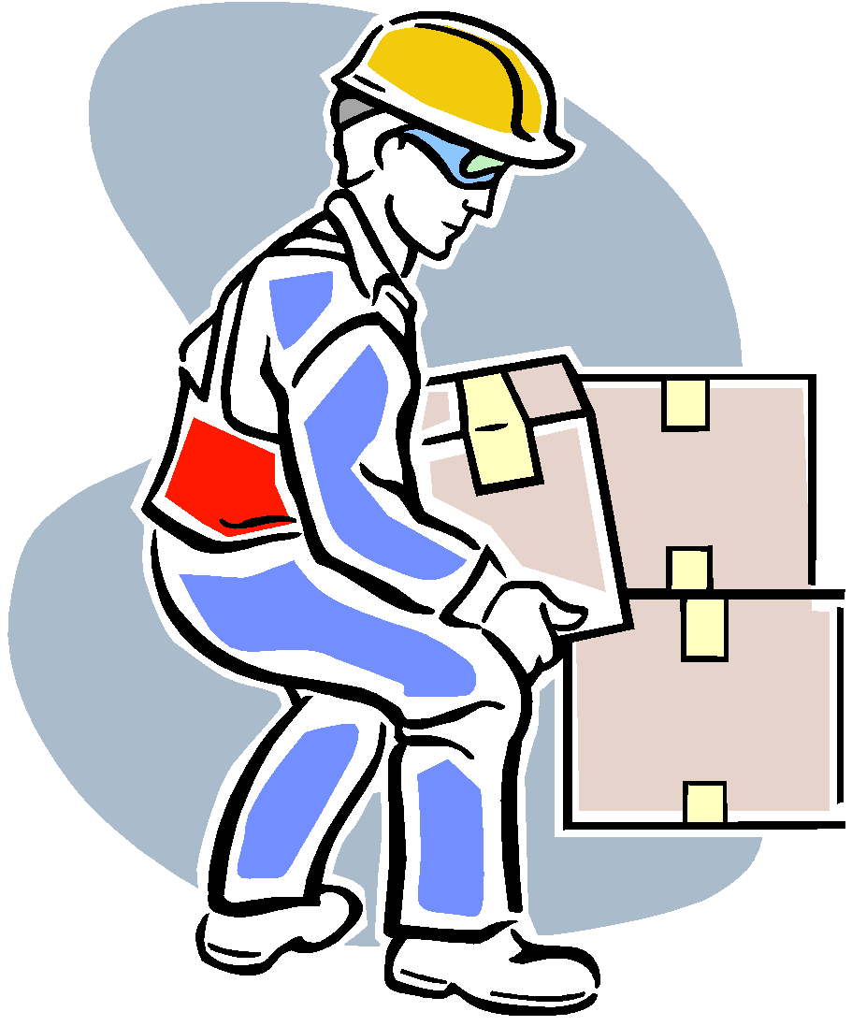
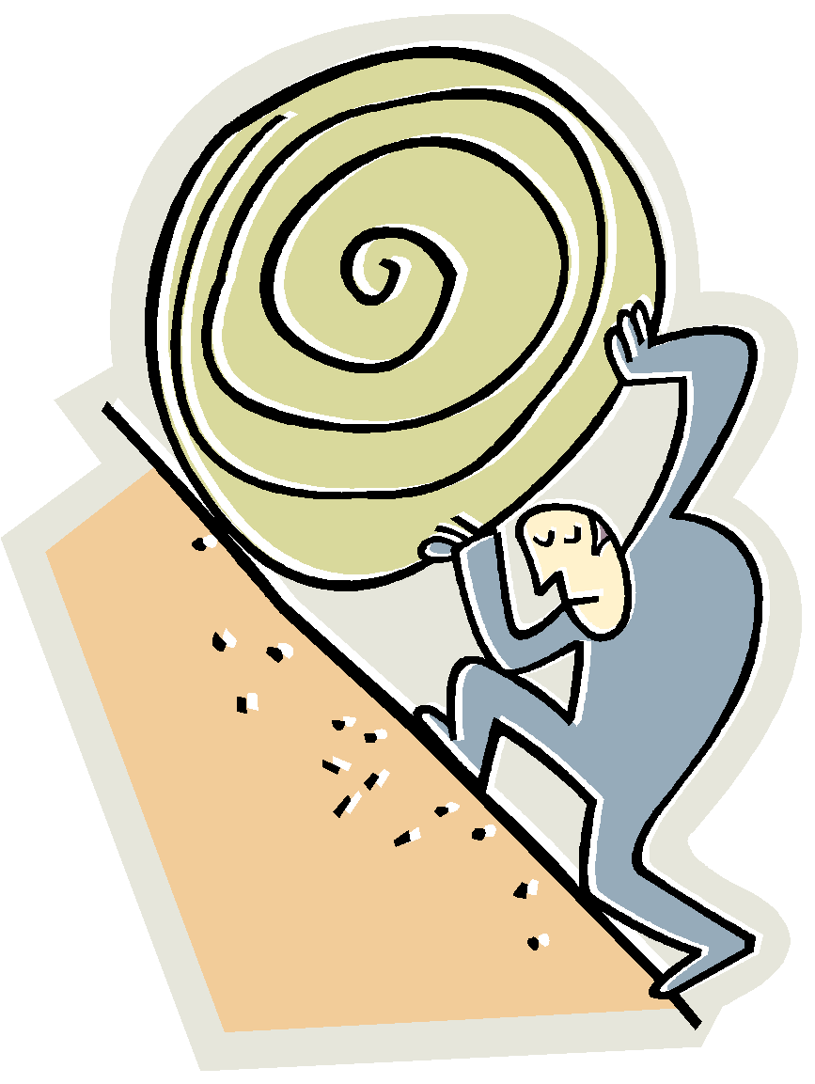

Power-How Fast Work is Done!
Power is the rate at which work is done. Power is increased when more work is done in a given amount of time, or when the time it takes to do the work is decreased.
Notes:
So what do you think of when you hear the word "power"? Do you think of Superman jumping over a building in a single bound? Or you do you think of a heavyweight boxer throwing a very powerful punch? Well, power actually is the amount of work done in a specific amount of time.
___
When the term **"power"** zips through your mind, does it conjure up images of a caped hero leaping skyscrapers at a single bound? Or perhaps a mighty boxer delivering a knockout punch with sheer force? Fascinating as they are, in the scientific cosmos, power is defined a bit differently. It's the measure of **work performed** within a certain slice of time.
So, whether it's a superhero or a star athlete, remember, in the world of physics, power is all about speed and efficiency in the galaxy of getting things done!

Slide 5

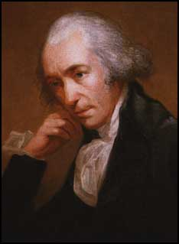
Calculating Power
Power= Work ÷ Time
Work is measured in joules, and seconds is the basic unit for time. Therefore, the unit used to express power joules per second, which is simply called the watt.
A unit named after Scottish inventor James Watt.
Notes:
You just learned that the unit of work is the joule, and the basic unit of time is the second. Therefore, the unit used to express power is joules per second which is more simply called the watt.
Let's look at an example of power. Suppose you and your friend were asked to unpack identical backpacks full of books. Your friend completes the task in two minutes while you complete the task in three minutes. Even though you both did the same amount of work, your friend used more power because he completed the task faster.

Slide 6
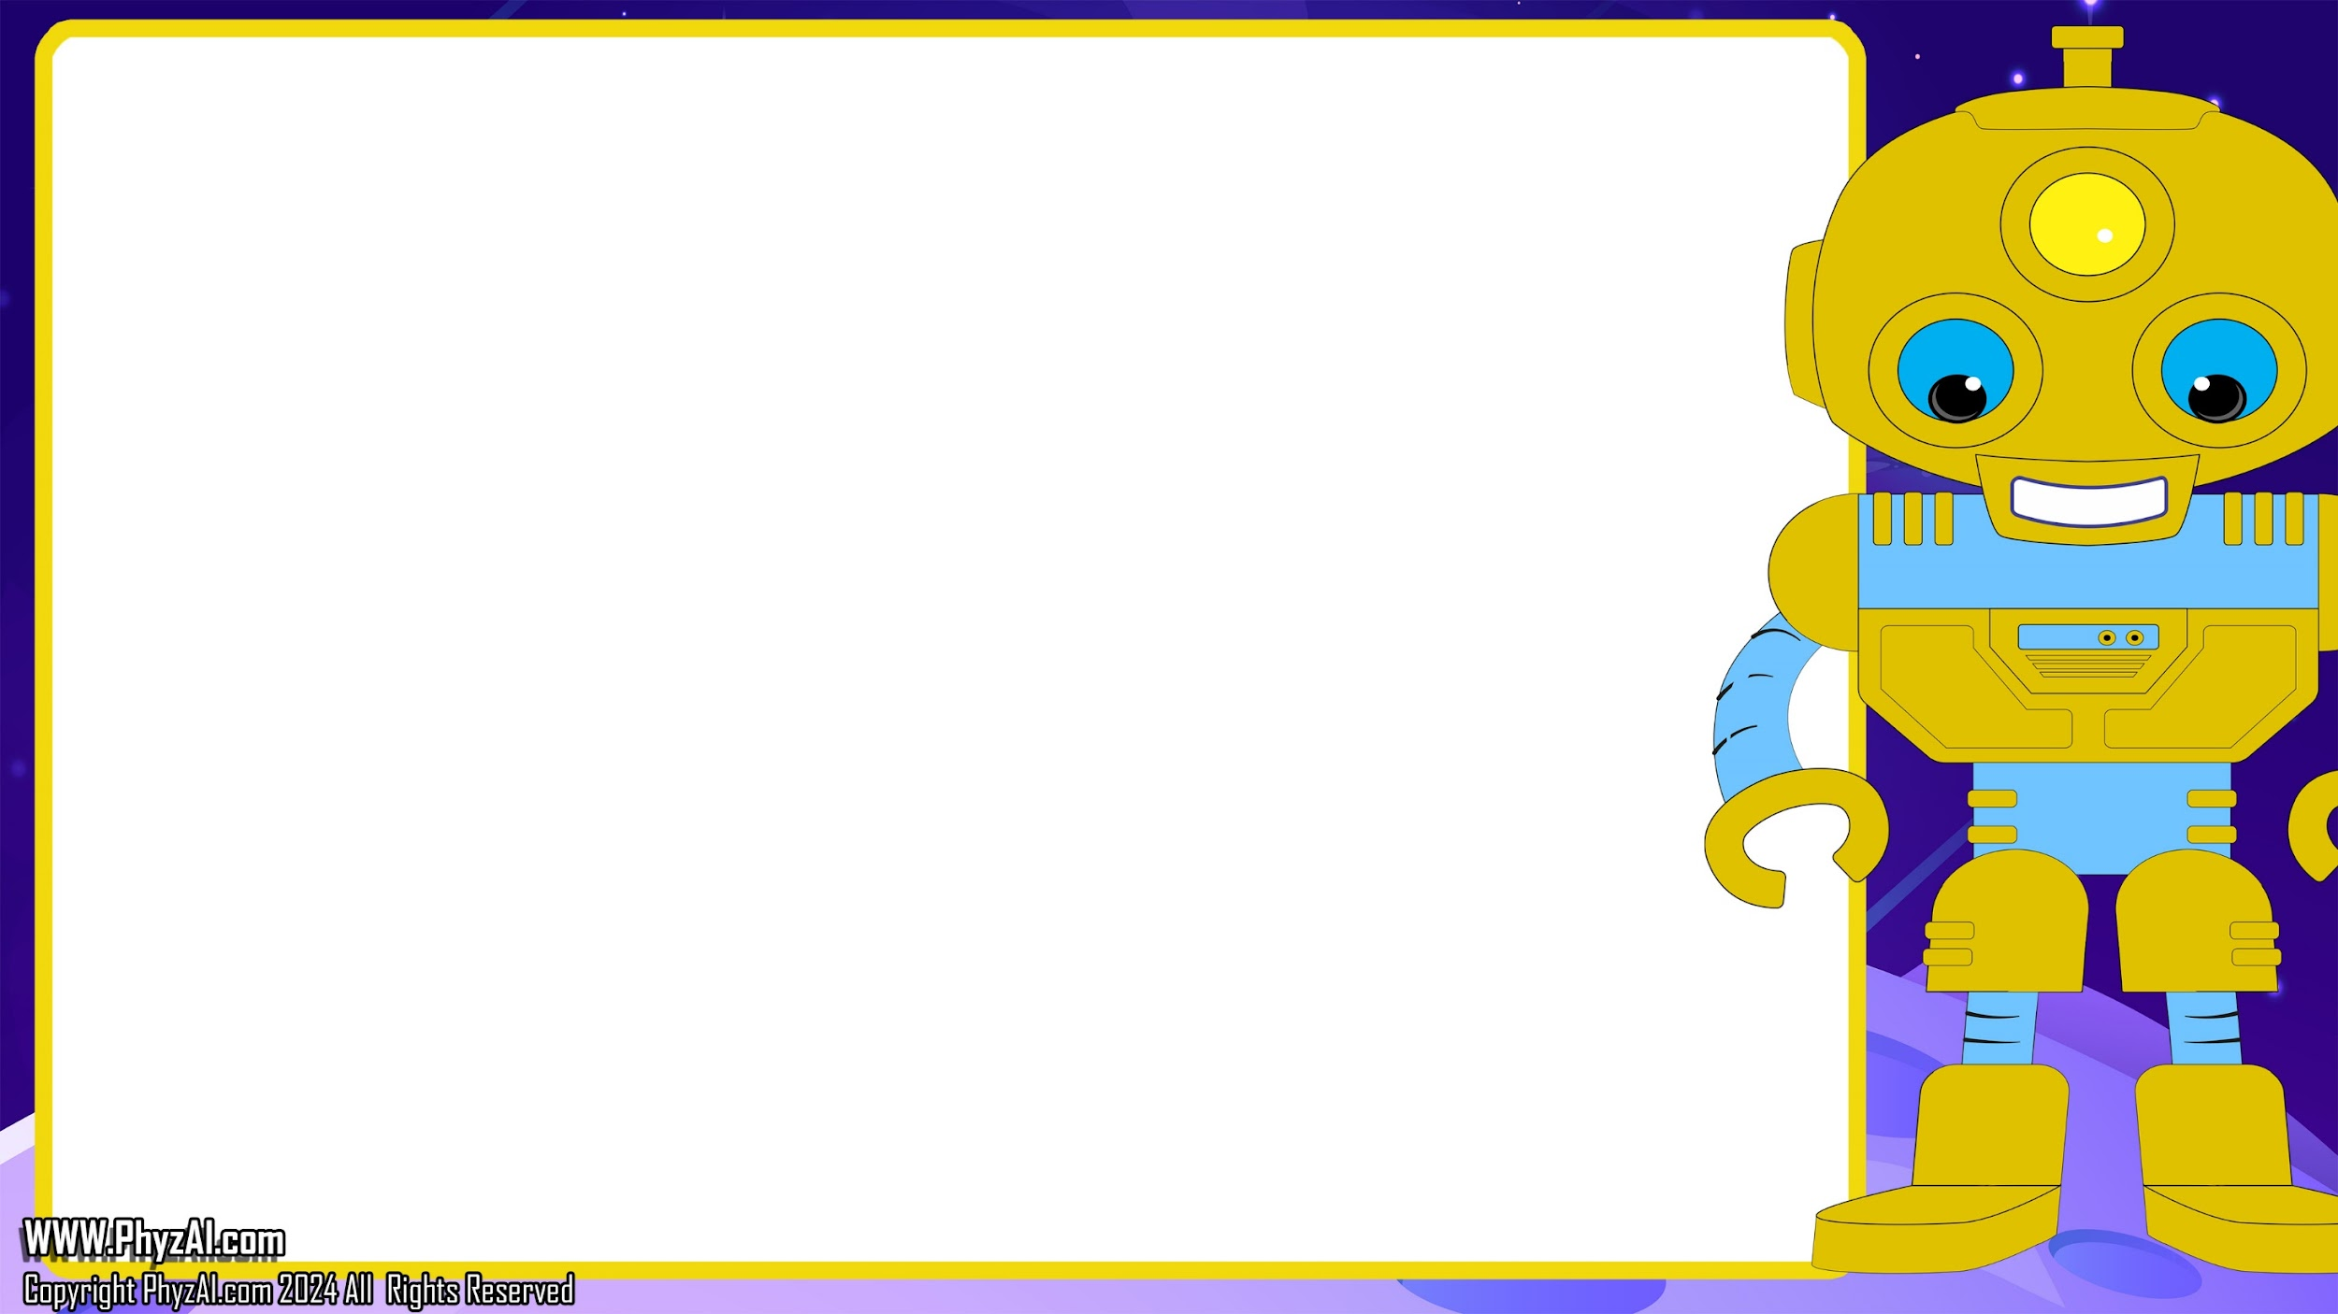
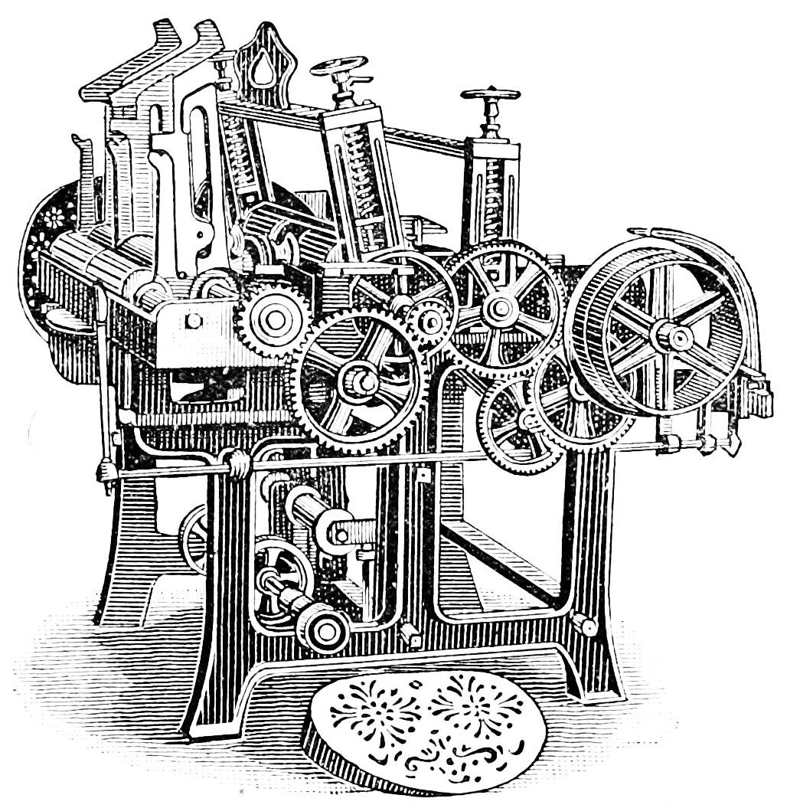
What is a Machine?
A machine is a tool with one or more working parts that makes work easier by changing the size, the direction, or the distance over which a force acts.
Notes:
If you look around you, you could probably identify one or more simple or complex machines. Machines make work easier for us humans by changing the size, the direction, or the distance over which a force acts.
_____
Cast your gaze across the cosmos, and you'll likely spot a myriad of mechanical wonders, both **simple** and **complex**. These machines are the unsung heroes that streamline our cosmic chores, changing the size, the direction, or the distance over which a force acts, making the impossible seem effortless.

Slide 7

Six Simple Machines
Wh
E
E
L
Load
Effort
Effort
Effort
LEVER
Axel
FULCRUM
Load
Load
Load
Effort
Wedge
Effort
Effort
Load
Load
Load
Notes:
The idea of a simple machine originated with the Greek philosopher Archimedes around the third century BC. Pictured here are six simple machines - the lever, the inclined plane, the wedge, the screw, the pulley, and the wheel & axle.

Slide 8
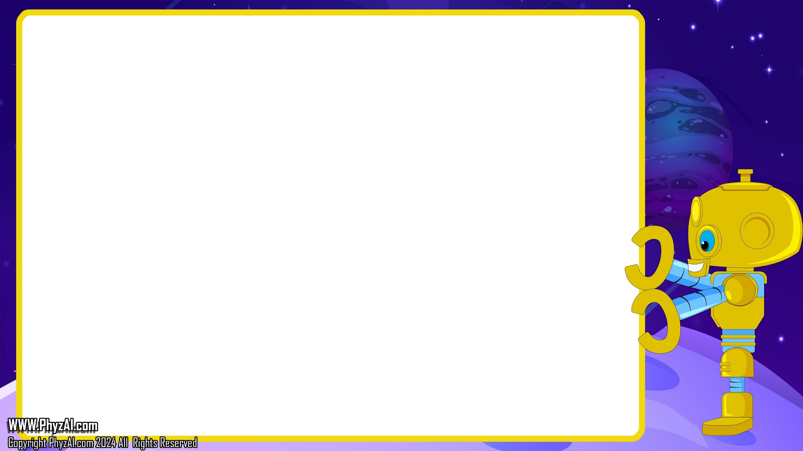
Mechanical Advantage
It is useful to think about a machine in terms of the input force (the force you apply) and the output force (force which is applied to the task).
When a machine takes a small input force and increases the magnitude of the output force, a mechanical advantage has been produced.
Notes:
We use machines to make our lives easier because they provide us with mechanical advantage. Some machines can increase force more than others. For example, a car jack. It takes the input force from our arms and translates it to output force strong enough to lift a car.

Slide 9
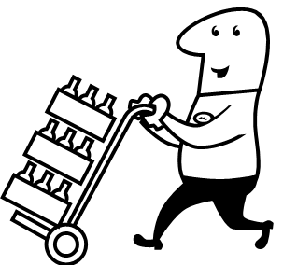
Calculating Mechanical Advantage
Mechanical Advantage = output force
Input force
A machine’s mechanical advantage tells how many times the machine multiplies force. Using the equation above, you can find the mechanical advantage of the handcart to be 10. Than means the handcart’s output force is 10 times greater than the input force.
Output force= 400 newtons
Input force= 40 newtons
Notes:
Mechanical advantage can be determined by dividing the output force by the input force. If the number you get is less than 1, that means that the input force was greater than the output force that the machine could provide. If the number you get is equal to 1, that means the machine only changed the direction of the input force. Of course, if the number you get from mechanical advantage is greater than 1, it means that the machine increased the input force by that magnitude.

Slide 10

Can you spot
the simple machines used to do work in these Hydro-Bot entries?
Notes:
Can you spot the simple machines used to do work in these Super-Lift entries?

Slide 11



Slide 12
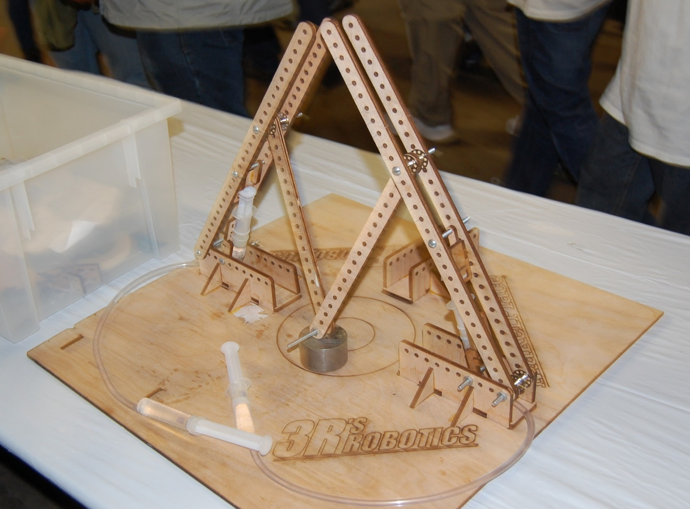

Slide 13

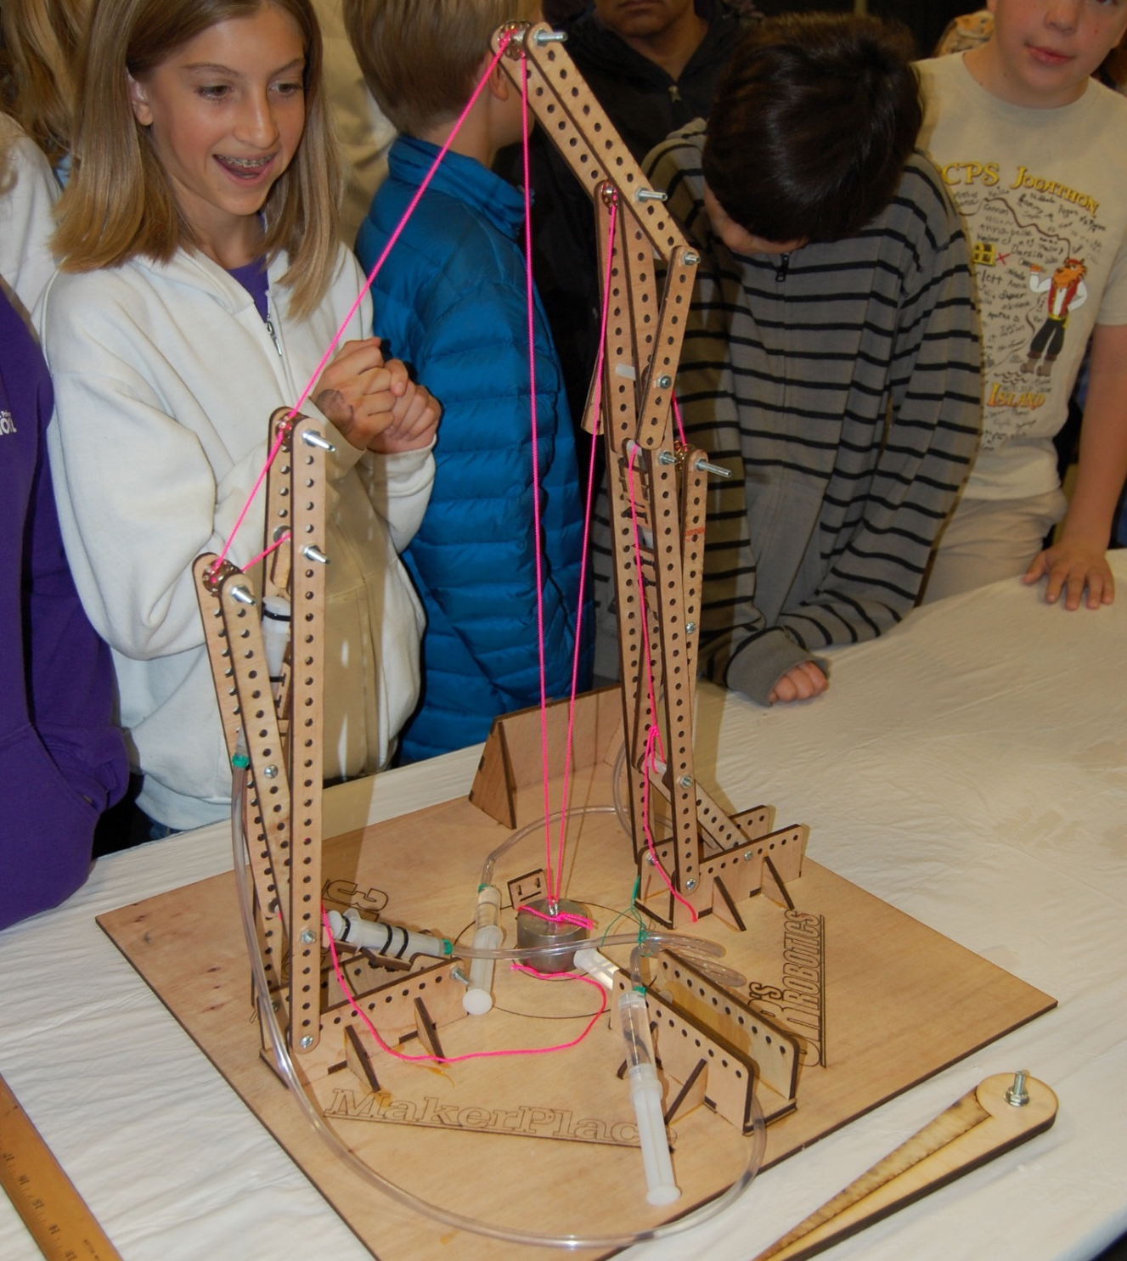

Slide 14
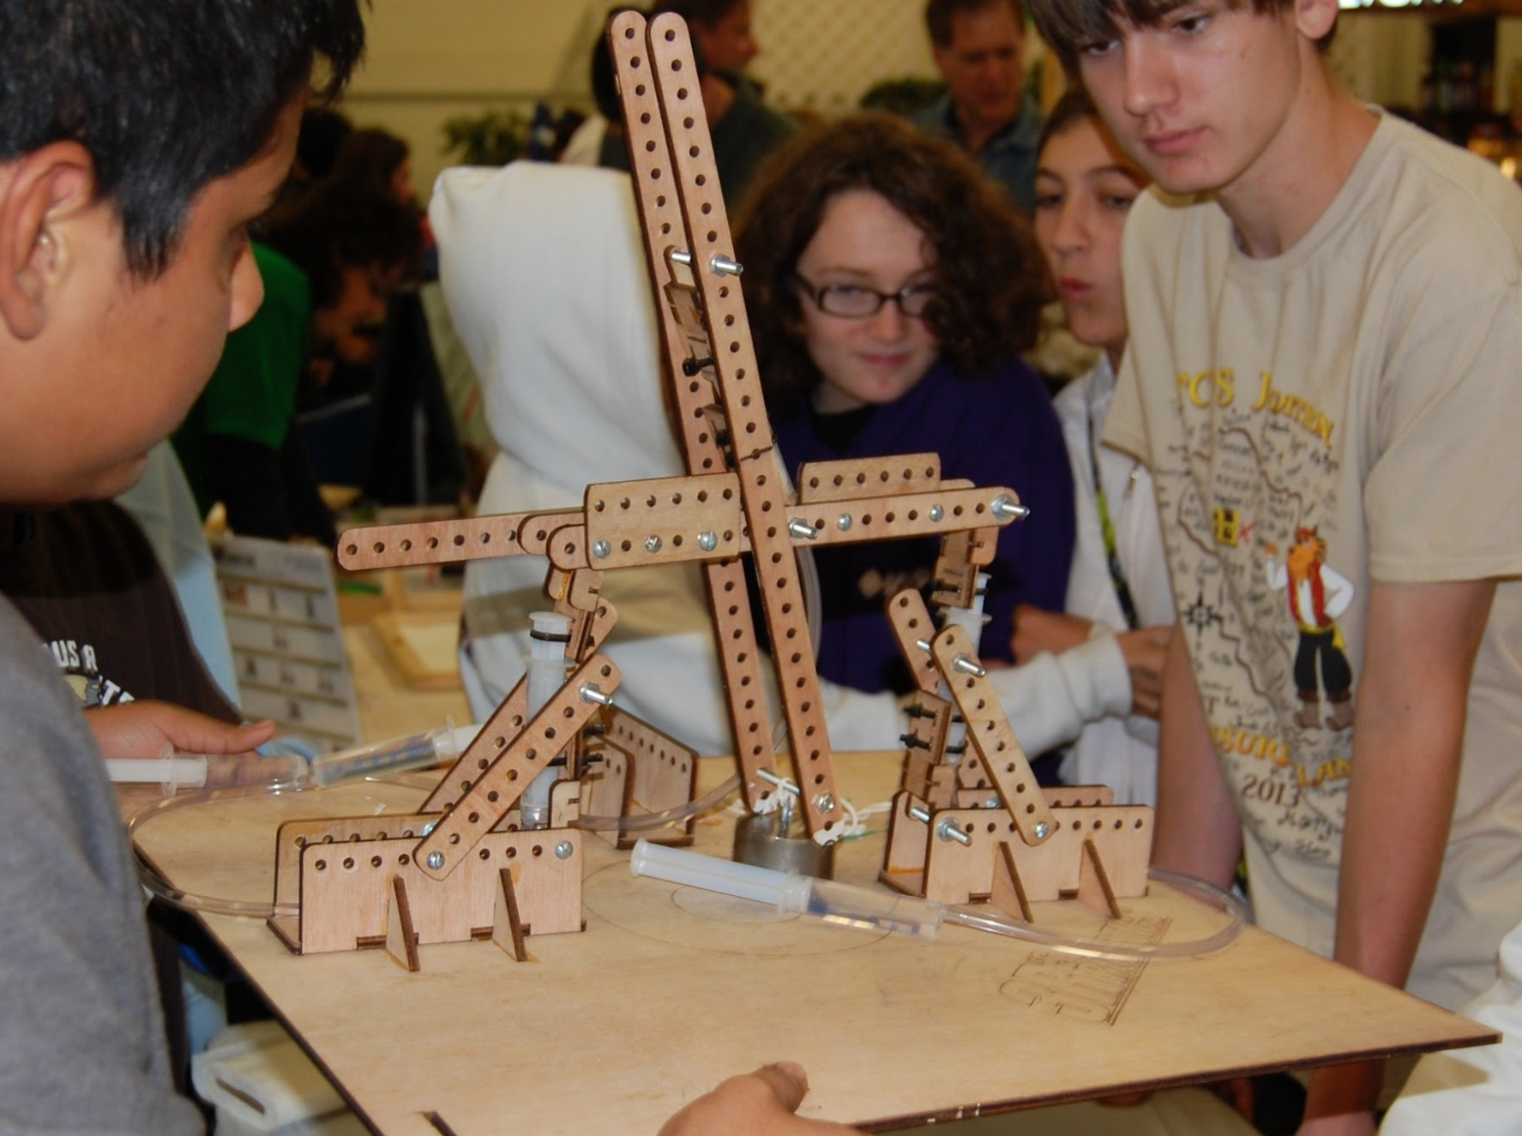

Slide 15
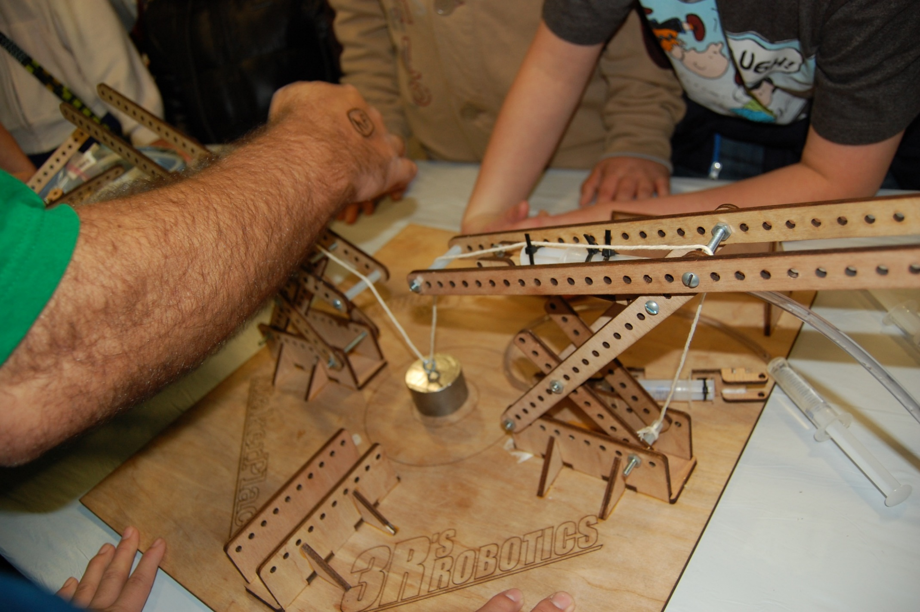

Slide 16

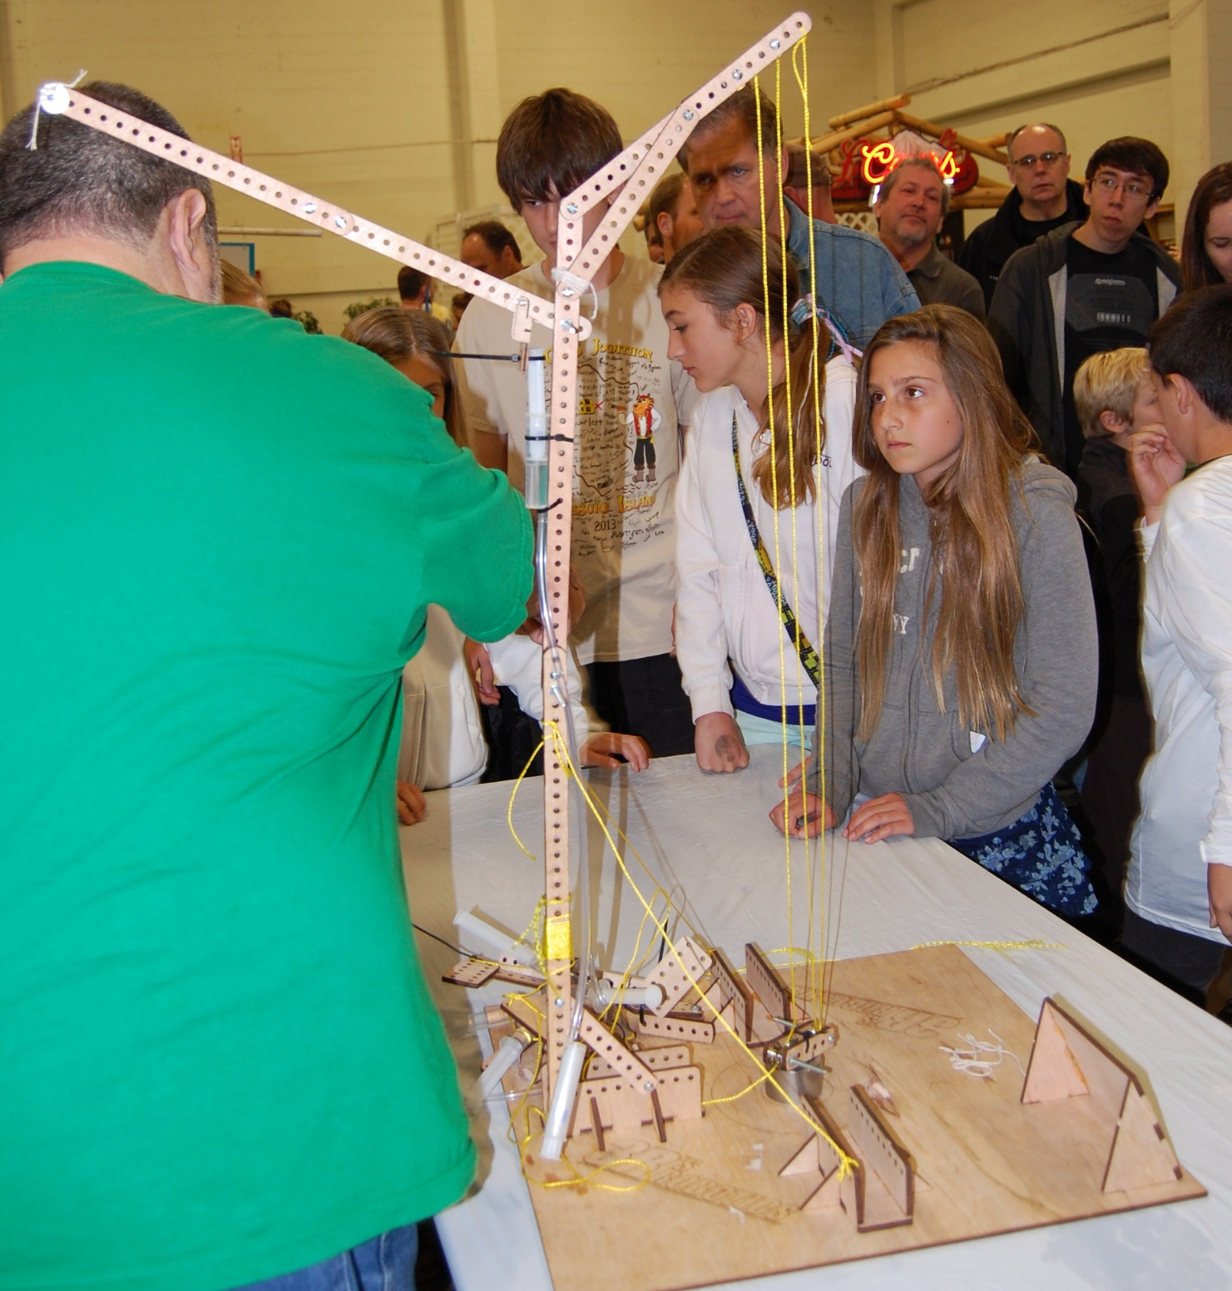

Slide 17

Winning teams always use components from all of the six simple machines.
Notes:
Winning teams always use components from all of the six simple machines.

